Slide 1
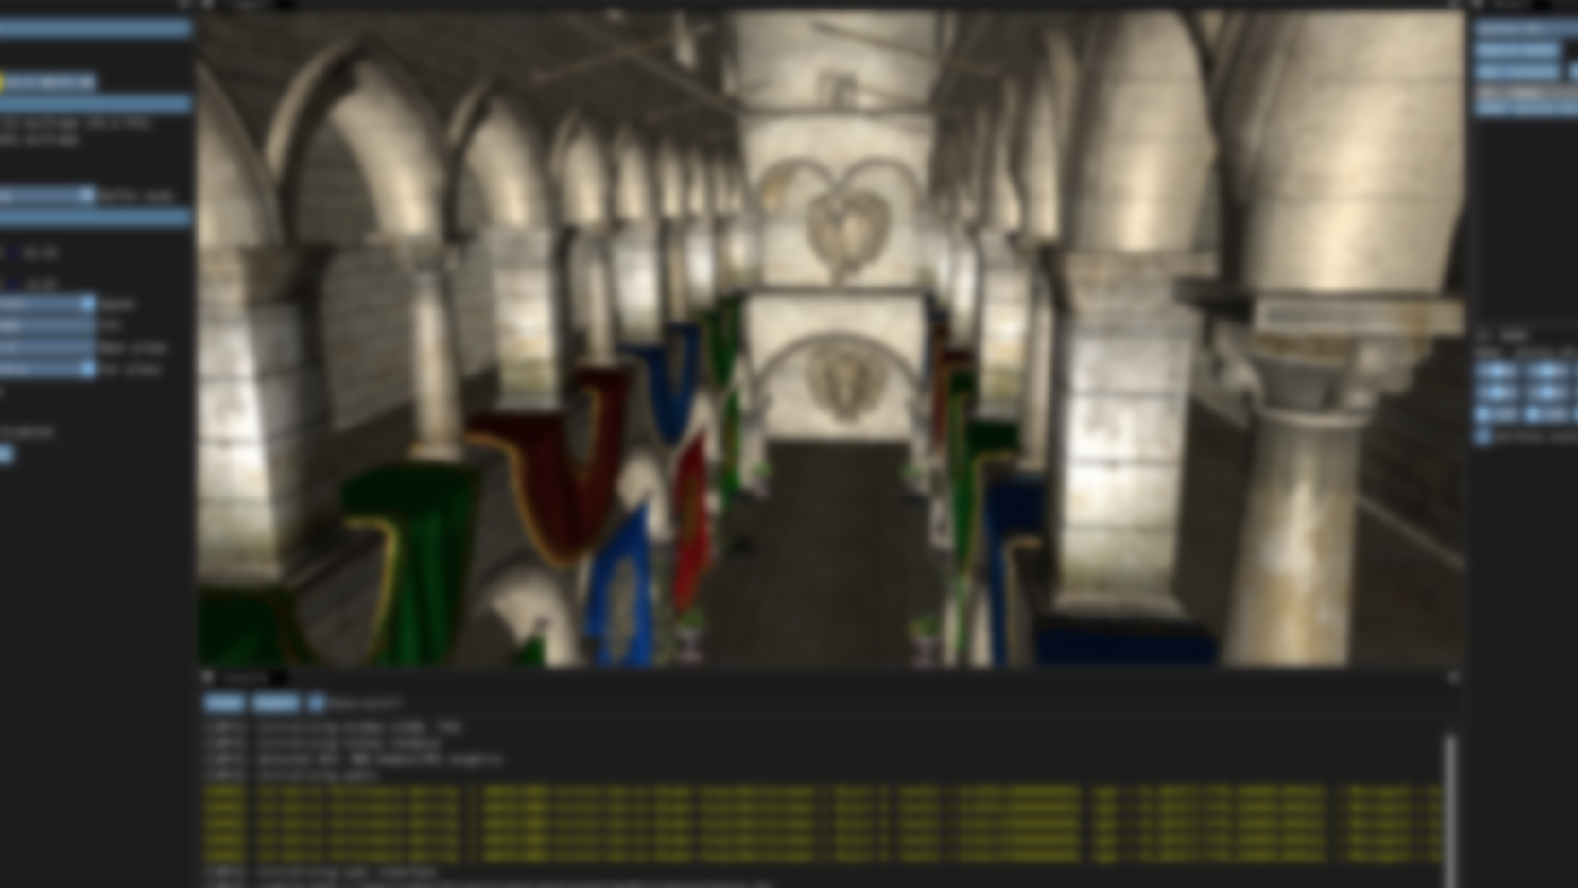
Progress Report
Milestones 3 & 4
By Zakariya Oulhadj

Slide 2
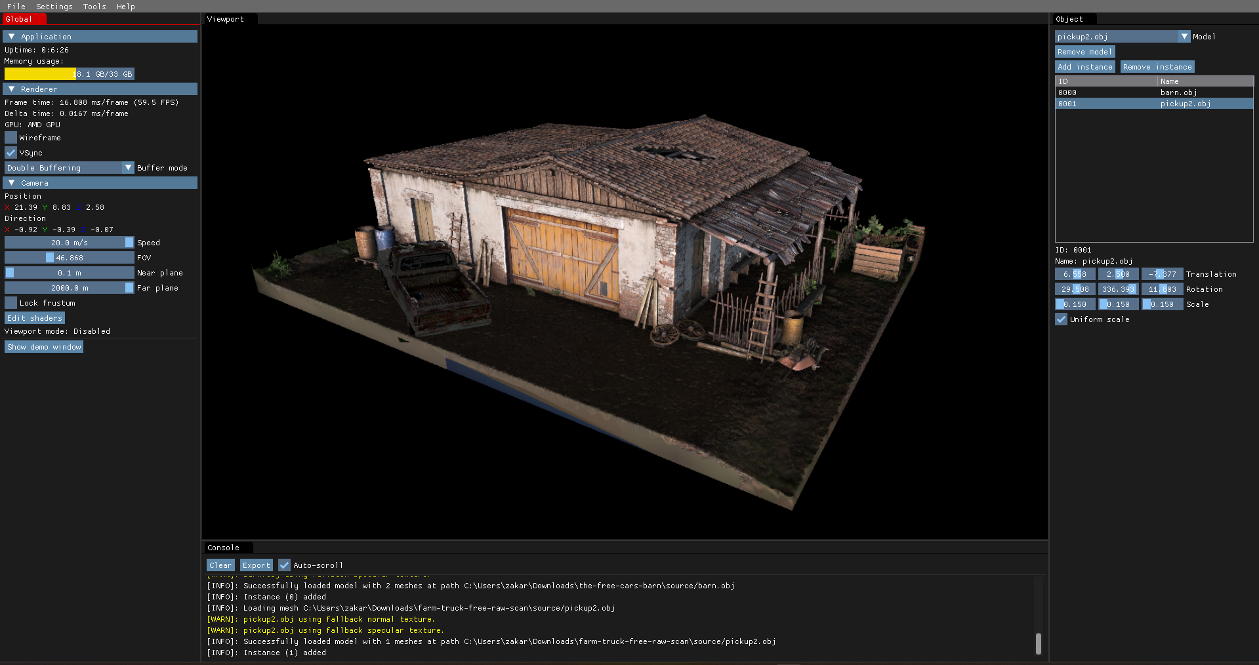
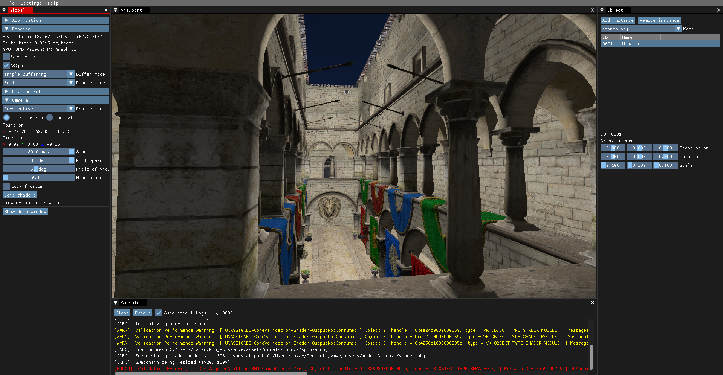
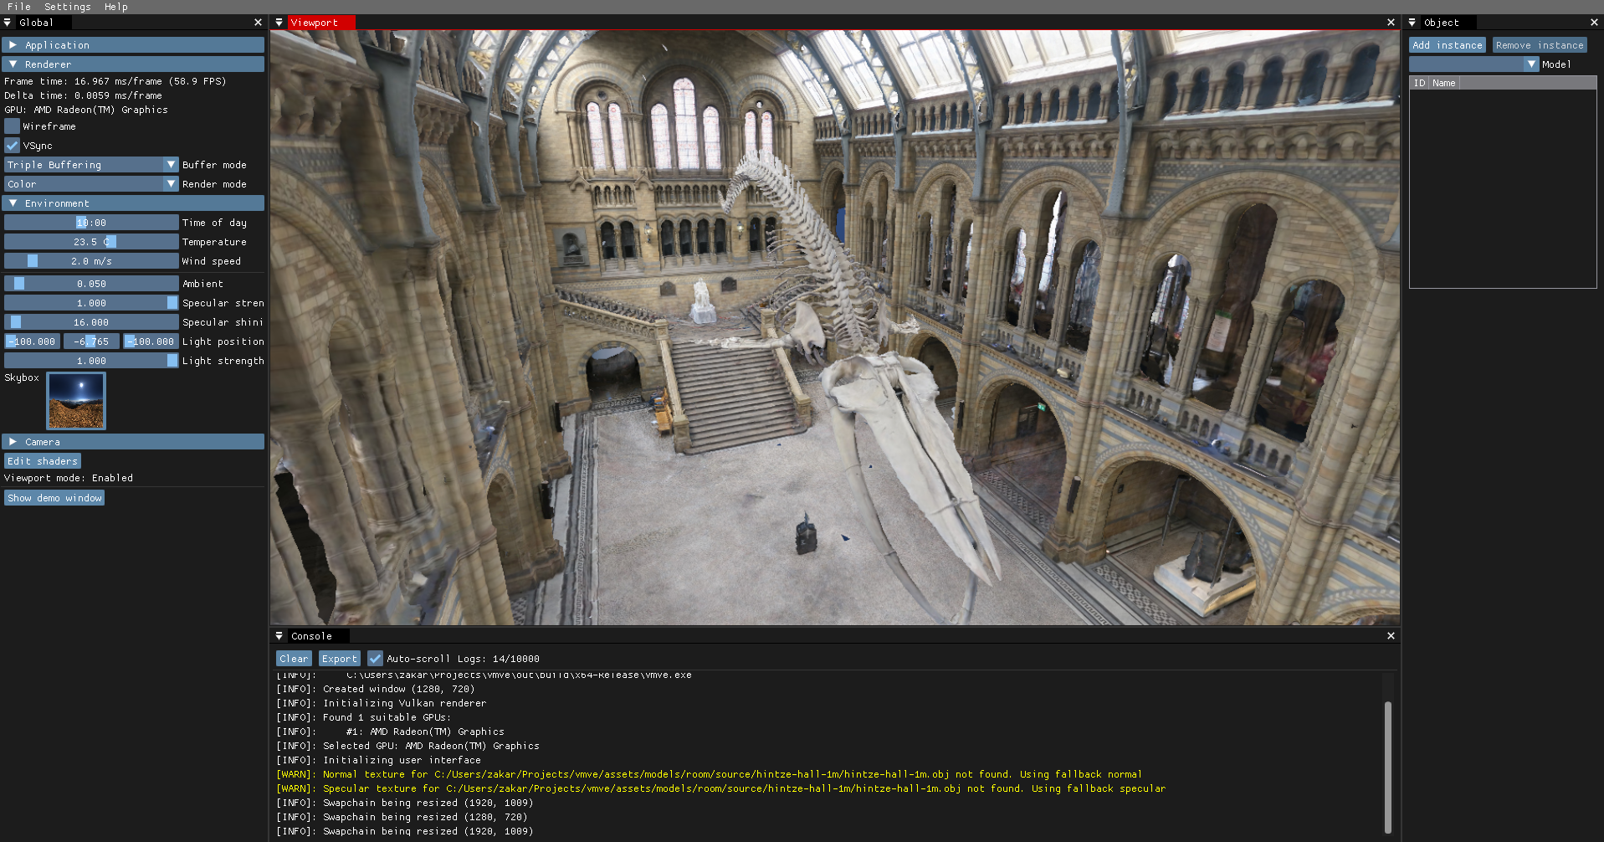
Overview
3D Model and Environment Visualiser
Quick model prototyping
Goal of being easy to use and lightweight
Version 0.0.1 released

Slide 3
Key Features
Model importing
Model/Scene interaction
Using latest rendering API (Vulkan 1.3)
Standalone executable
Easy to download and use
Internal engine can be used for other applications
Dedicated project website
Notes:
Additional features:
Reversed depth buffer
Deferred rendering pipeline

Slide 4
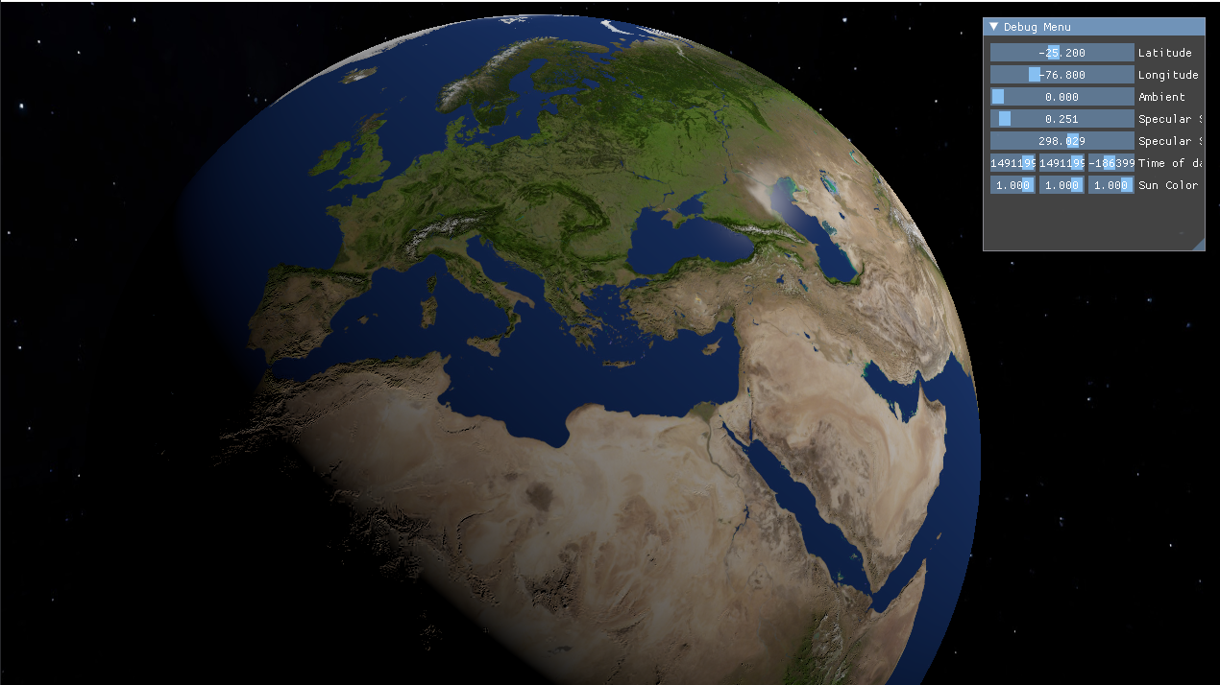
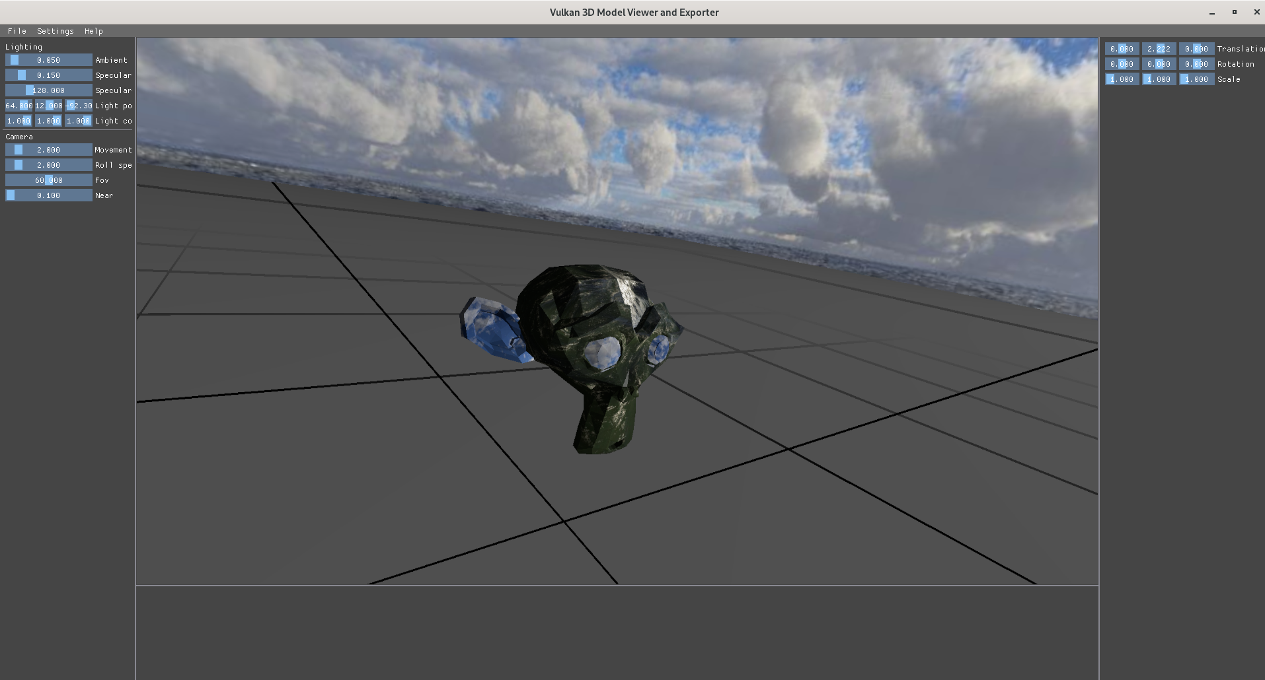
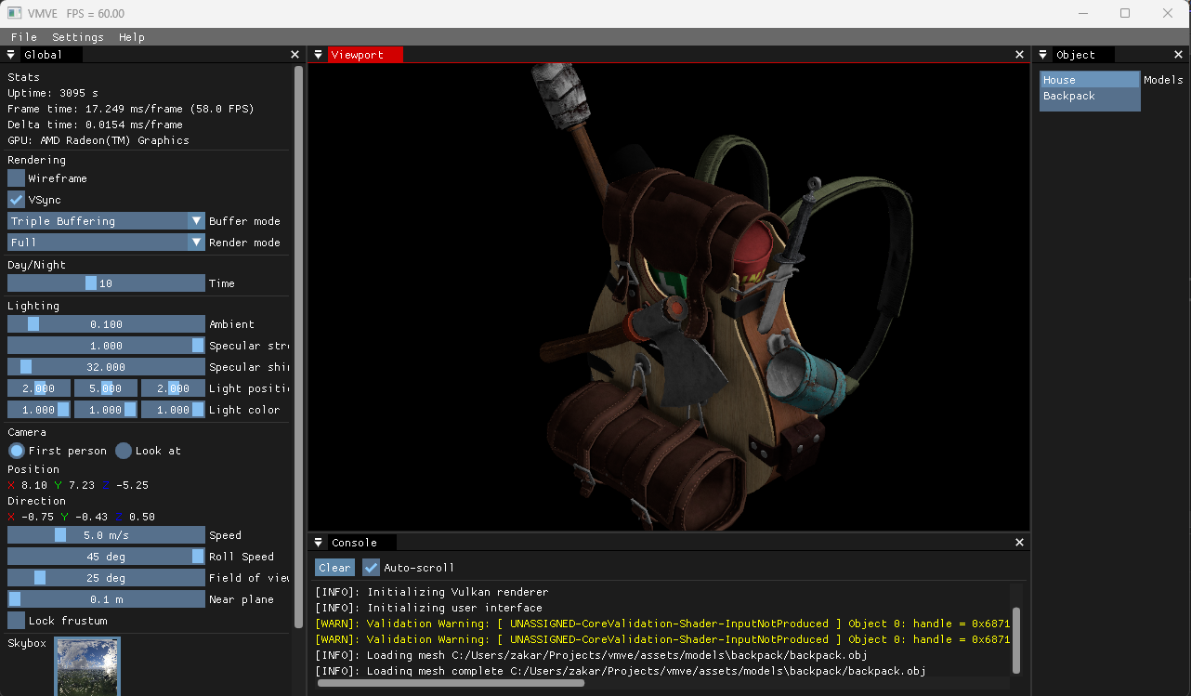
Progress
220+ commits
5000+ Lines of code
30 Milestones/Issues Resolved
29th October
13th November
14th December
27th December

Slide 5
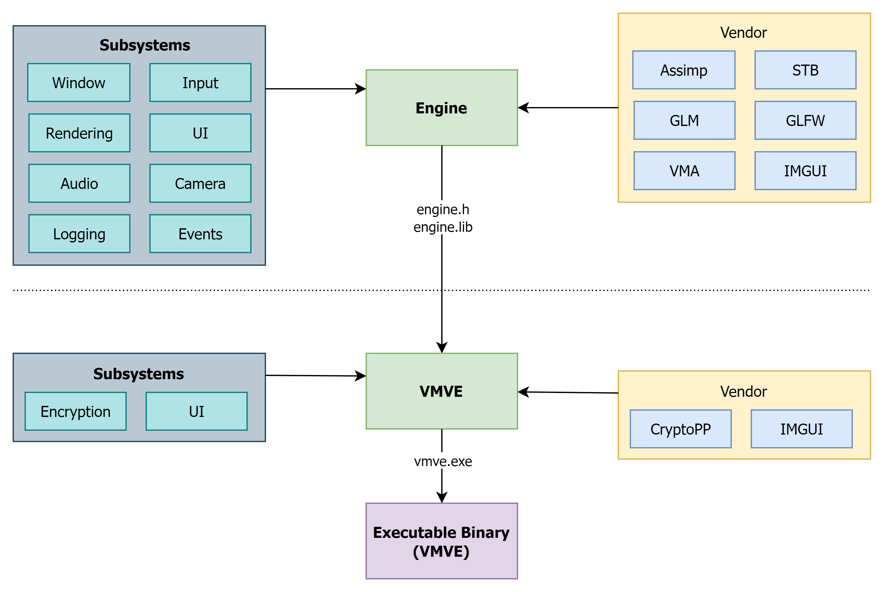
Project structure

Slide 6
Project Demonstration
Notes:
Exit the PowerPoint and present the application

Slide 7
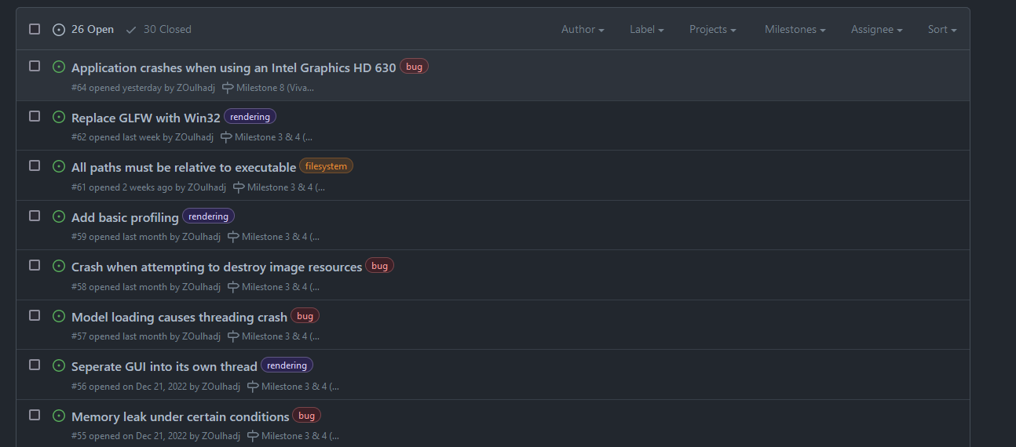
In Development
VMVE Model/Scene Encryption (AES, DH)
Low-level optimisations
Fixing bugs
Project distribution
Report
Notes:
Projection distribution – So that the application an run on most computers.
Long-term features:
Support for glTF model format
DirectX 12 support
Reduce library dependencies (GLFW, GLM)

Slide 8
End of Presentation

